Slide 1

Module 1.2 Software

Slide 2
CONTENTS
Application versus system software
The operating system
Application software
Test and improve

Slide 3
Application versus system software
Application software
Group of programs that perform specific tasks for us as users
Word processing programs
Typing Tutor software
Gaming software

Slide 4
Application versus system software
System software
Software that is intended to control, support or operate the computer
Operating system
Utility software

Slide 5
The operating system
Software which controls all activities that
take place inside the computer
Windows 8, Windows 10
Apple’s macOS Sierra
Apple’s IOS
Linux (Ubuntu)
Android
Windows for smartphones

Slide 6
The operating system
Functions of the operating system
Managing all the hardware and software on the computer
Maintaining security (with the use of passwords, etc.)
Providing a user interface

Slide 7
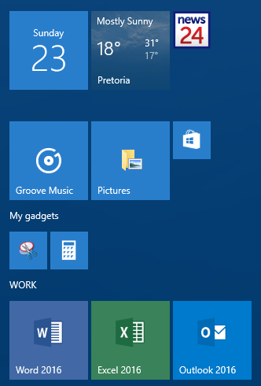
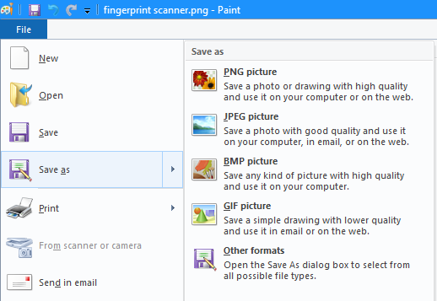
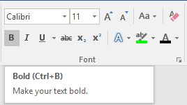
The operating system
Graphical User Interface
desktop
menus
Shortcut keys

Slide 8
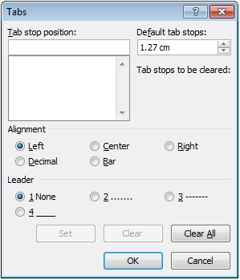
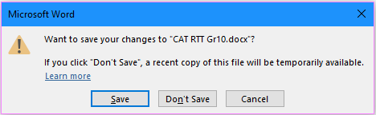
The operating system
Other Windows components
Textbox
dialogue box
Spinner
Radio button
Command button

Slide 9
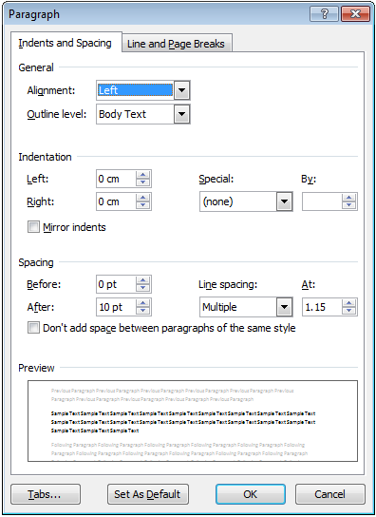
The operating system
Other Windows components – continued
Tab in dialog
Combo and List box
dialogue box
Check box

Slide 10
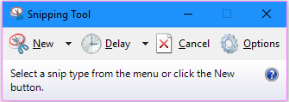
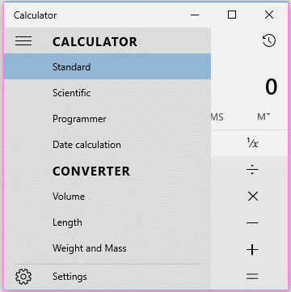
The operating system
Utilities
Snipping Tool
Calculator

Slide 11
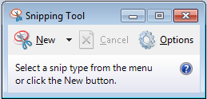
Activity 1

Slide 12
Application Software
Office suite
Word processor
Spreadsheet
Database
Presentation software

Slide 13
Application Software (continued)
Communication software
Desktop publishing
Games
Web authoring software

Slide 14
Application Software (continued)
Web browser
Plug-ins
Financial applications

Slide 15
Test and improve
Application vs. system software
Functions
Windows
Windows range – Windows 8 / 10
macOS, OS X
Application software –performs a specific task
Desktop
Icons, tiles, shortcuts
Sub-menus and shortcut keys
Windows components
System software – controls, supports or operates the computer
The operating system
Mobile devices –
iOS, Android
Useful programs

Slide 16
Written module activity

